Slide 1
Visualizations of Netflix Stock
By Shakeel Khan

Slide 2
Overview
Visualizations included in this presentation will cover
  Distribution of stock prices each quarter
  Performance of the eaearnings and revenue
  Netflix stock compared rnings per share
  Summary of the to the Dow Jones Industrial Average
My role as a data visualization developer at Yahoo! Finance is to create these visualizations in hopes to help the Netflix Stock profile team easily visualize Netflix Stock data in 2017 through producing this stock profile.

Slide 3
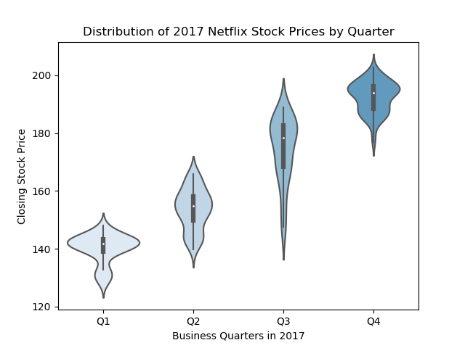
Distribution of Stock Prices
In the 1st, 2nd, and 3rd quarter prices (at some point in the quarter) were still hovering around $135-140 (showing it’s not consistent)
(Approximate) Price ranges by quarter:
  Q1: $125-150
  Q2: $135-170
  Q3: $135-195
  Q4: $175-205
The lowest prices occurred in Q1 where they were as low as $125
The highest prices occurred in Q4 when they were about $205
Notes:
Majority of the stock in Q1 hovered around 141 or 142 dollars, as the graph is skewed to the right
The prices in Q2 were pretty well distributed with a wider range than Q1, most of the prices accumulated around the $155 price point
Prices in Q3 were spread out even more, though we can see that the prices spiked at $185 as the graph was skewed to the right with the rest of the graph being real thin
Prices in Q4 had a range much shorter than Q2 or Q3, however it was a much higher range. The curve of the graph is bimodial indicating majority of the price hovered around $185 and $195

Slide 4
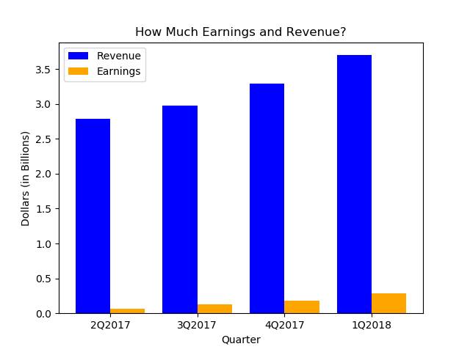
Earnings and Revenue
The revenue rose about 6-12% every quarter
  About 6% in Q3 2017
  About 10% Q4 2017
  About 12% Q1 2018
Earnings rose about 30-50% every quarter
  About 50% Q3 2017
  About 30% Q4 2017
  About 36% Q1 2018
Typically, 2-8% of the revenue ended up being the earnings
  About 2% Q2 2017
  About 4% Q3 2017
  About 6% Q4 2017
  About 8% Q1 2018
Notes:
The amount of revenue that ended up being the earnings typically rose 2% every quarter
The amount that the earnings rose by was not real consistent from one quarter to another
The amount that the revenue rose every quarter was fairly consistent but it slowed down in the 1st quarter of 2018

Slide 5
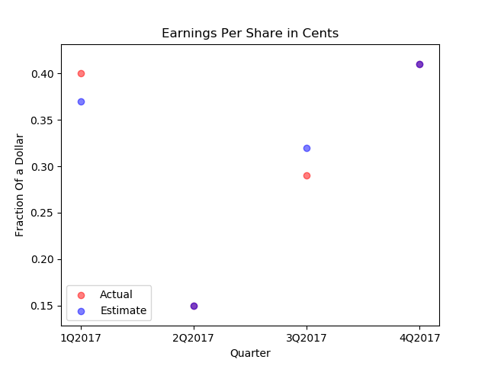
Earnings Per Share
Earnings per share and estimates where either very close or dead accurate
The highest earnings made was $0.41 in Q4
The lowest earnings made was $0.15 in Q2
The actual amount made and the estimate where the same in Q2 and Q4
The average error between int the Actual earnings per share vs the estimate is ±0.03

Slide 6
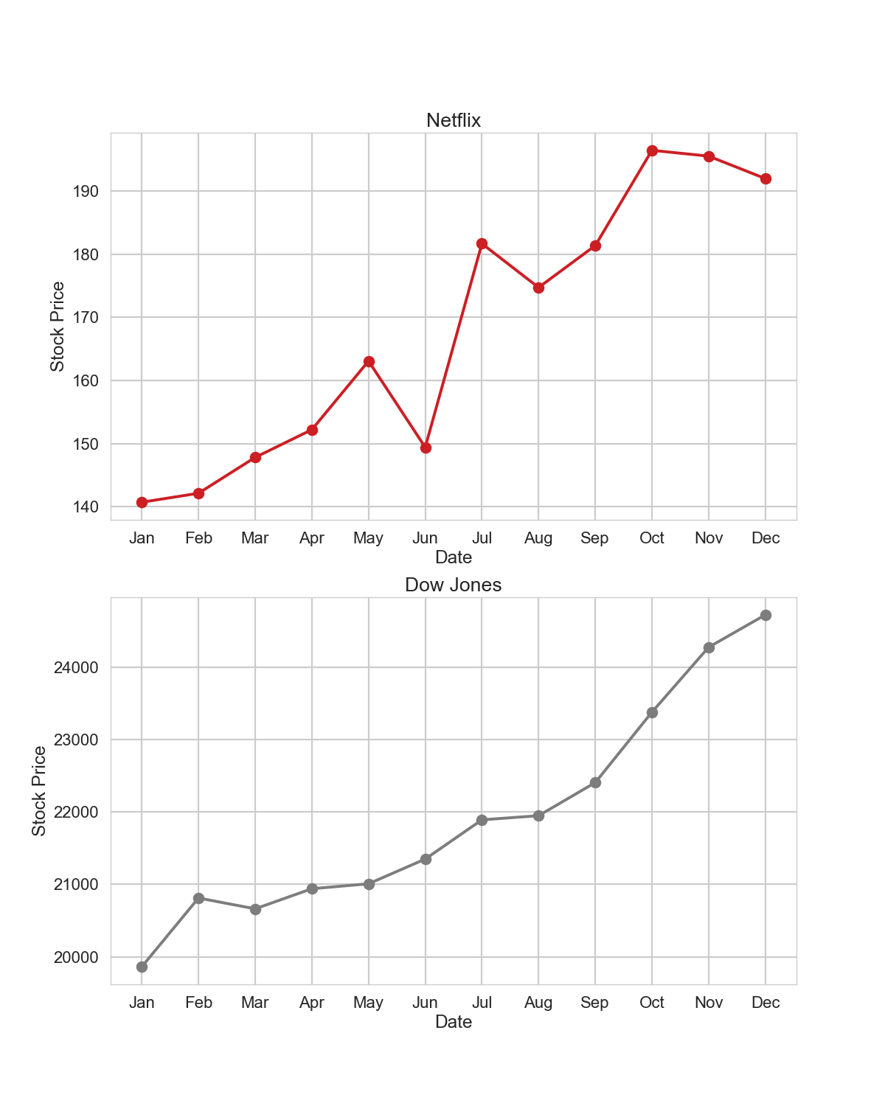
Netflix Vs Dow Jones
In the 1st quarter the Dow Jones Industrial Average performed better than Netflix stock
While in the 2nd and 3rd quarters Dow Jones maintained consistency and continued climbing, Netflix Stock crashed in the end of the 2nd quarter but spiked during the beginning of the third quarter, ending at a price slightly lower than what they started at
In the 4th quarter Netflix started doing better than Dow Jones but towards the end the consistency of the Dow Jones made it end in a better position than Netflix
We can conclude that Netflix stock is far more volatile
Dow Jones has far more consistent prices, showing the general market was doing much better than Netflix

Slide 7
Thanks for Watching!

